Slide 1
Contrastive learning
Background
Presenter: Changyu Deng
February 2020

Slide 2

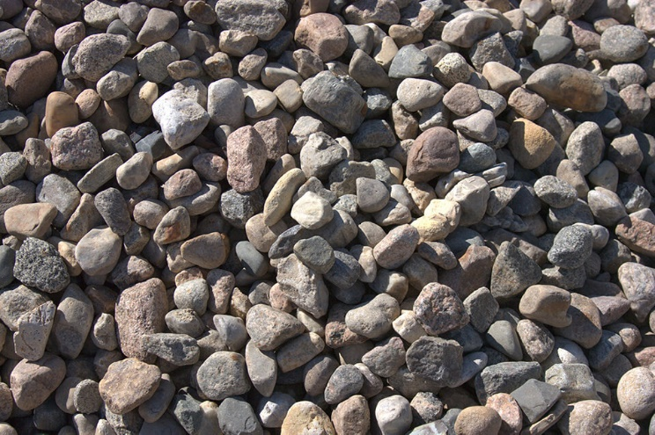
Motivation
Scope: self-supervised representation learning
No labels
To extract features (representations)
Why?
Labeled data
Unlabeled data
https://www.marketwatch.com/story/gold-heads-for-back-to-back-loss-amid-vaccine-hope-us-dollar-strength-2020-09-03
https://serbu.ca/different-types-of-rocks-stones-and-aggregates/

Slide 3
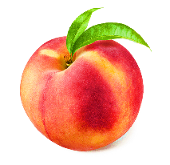
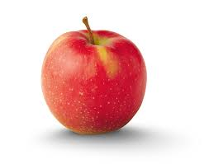
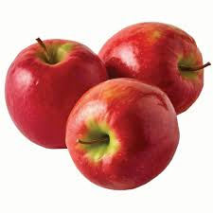
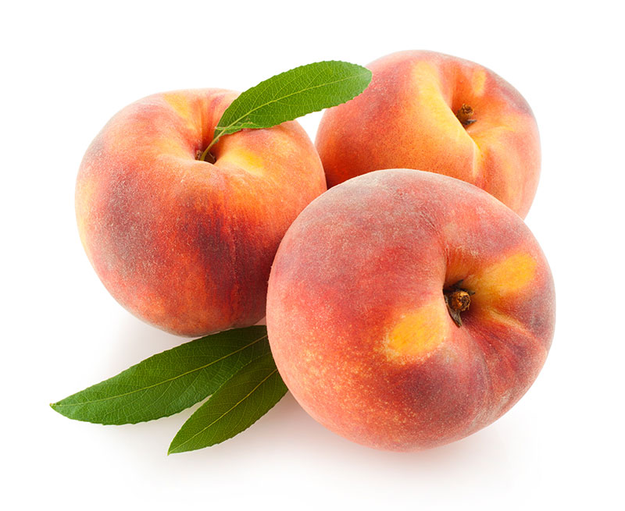
Motivation
How? Let us classify the following images into 2 categories
Every instance image has its own feature/representation
Can we learn representation by discriminating instances?
https://billsberryfarm.com/produce/peaches/
https://www.applesfromny.com/varieties/jonagold/
https://www.heb.com/static-page/apple-varieties
https://www.freshpoint.com/archive/commodity-stone-fruits-peach-yellow/

Slide 4
Motivation
A naïve idea: train a classifier to classify N images into N categories.
Softmax
…
Impractical, too many categories.

Slide 5
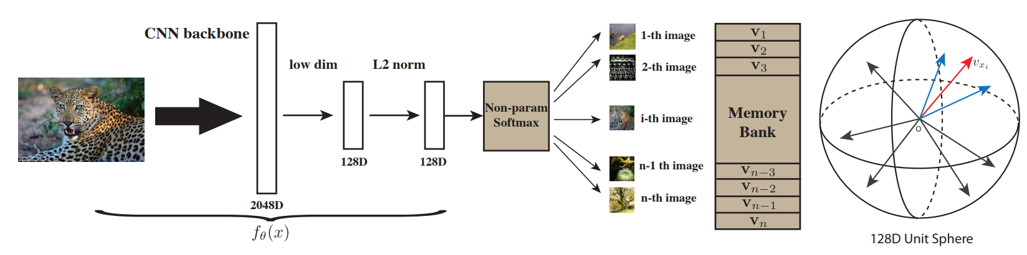
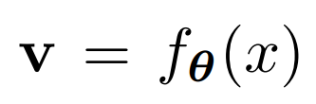
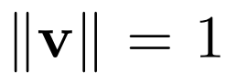
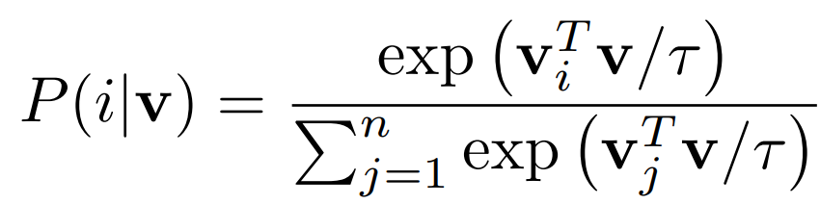
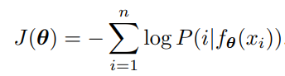
Memory bank
Non-Parametric Instance Discrimination
We reduce the dimension of classifications
We want to learn
subject to
Non-parametric softmax
Loss
Wu, Zhirong, et al. "Unsupervised feature learning via non-parametric instance discrimination." Proceedings of the IEEE Conference on Computer Vision and Pattern Recognition. 2018.

Slide 6
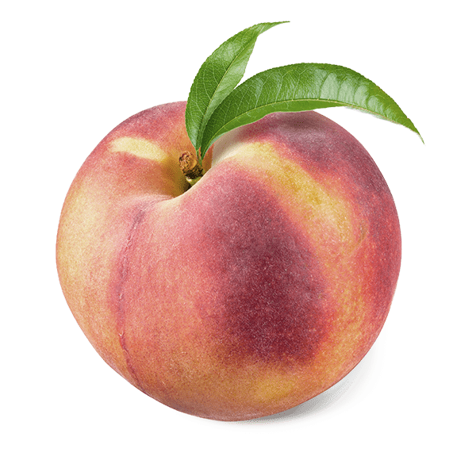
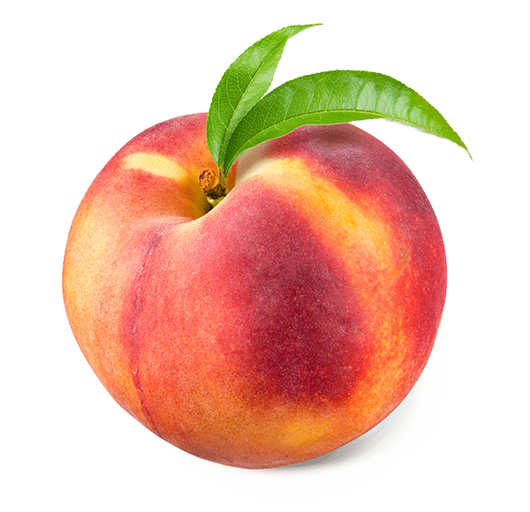
Motivation
Can we incorporate more semantic info? Let us classify the following images into 2 categories
What are the attributes to distinguish between these two types of objects
Shape? Yes
Texture? Yes
Color? Maybe
Orientation? No
Image size? No
Location? No
The views are generated from 2 images by data augmentation
Know the “category” of views without label
Train the network to discard unneeded attributes
https://billsberryfarm.com/produce/peaches/ https://www.applesfromny.com/varieties/jonagold/

Slide 7
Motivation
Another naïve idea: train a classifier to classify N images (unlimited views) into N categories.
Softmax
…
Impractical, too many categories.

Slide 8

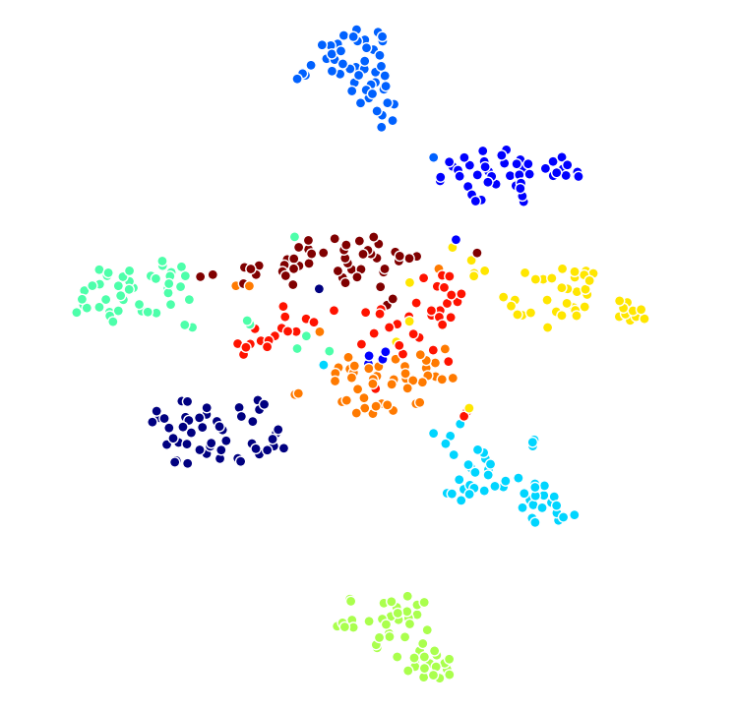
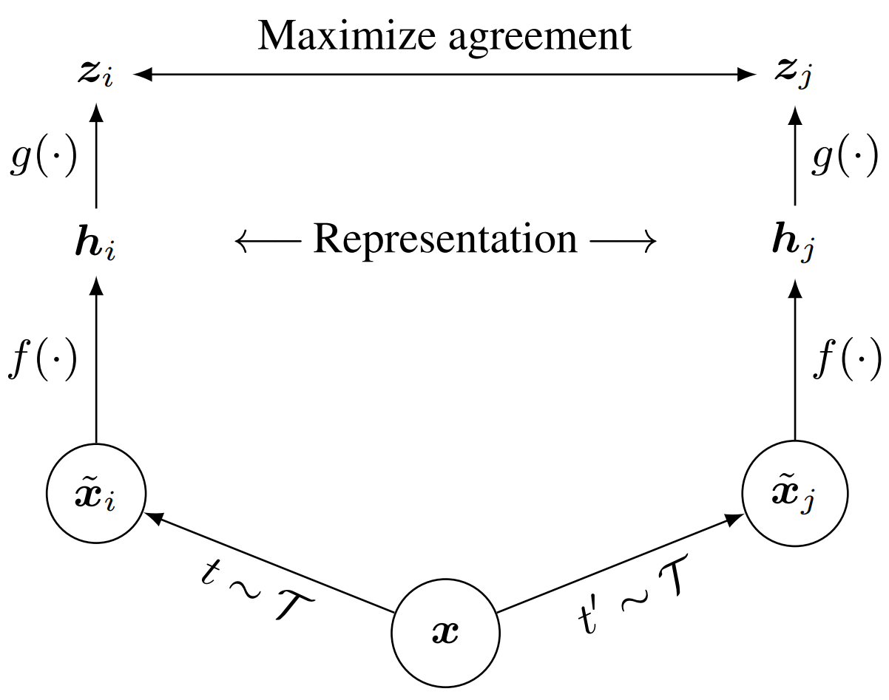
SimCLR
SimCLR
Use data augmentation to generate views
Measure the distance between representations
Cluster representations of views
Chen, Ting, et al. "A simple framework for contrastive learning of visual representations." International conference on machine learning. PMLR, 2020.

Slide 9
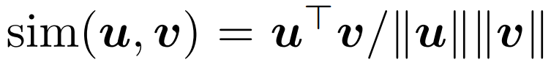
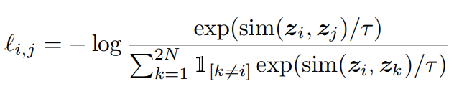
SimCLR
First define distance by inner product
Then define loss function by distance
For a positive pair of views i,j (from the same image)
InfoNCE
To make this work, we need
Large batch size (256-8192 in the paper)
Various data augmentation techniques
Chen, Ting, et al. "A simple framework for contrastive learning of visual representations." International conference on machine learning. PMLR, 2020.

Slide 10
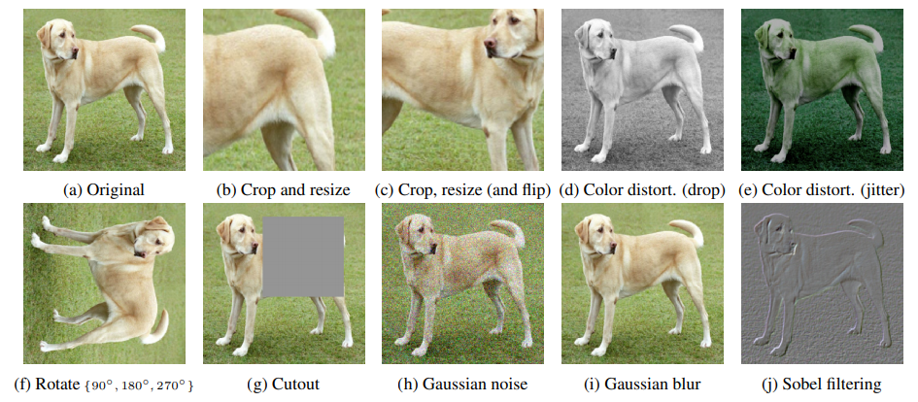
SimCLR
Data augmentation used in SimCLR
Chen, Ting, et al. "A simple framework for contrastive learning of visual representations." International conference on machine learning. PMLR, 2020.

Slide 11
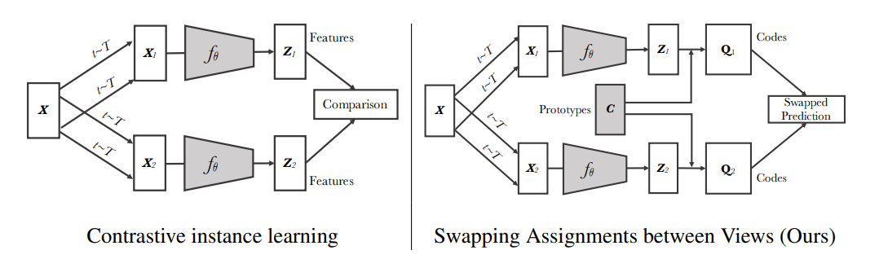
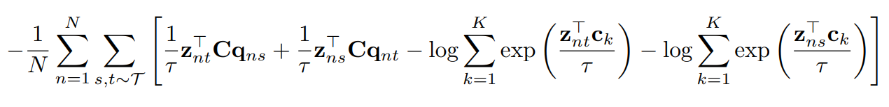
SwAV
SwAV: use given number of clusters/categories
Loss
To avoid trivial solution, Q is regularized by complicated constraints
High entropy
Equal partition of images by prototypes (clusters)
A large batch size or memory bank is needed
Caron, Mathilde, et al. "Unsupervised learning of visual features by contrasting cluster assignments." arXiv preprint arXiv:2006.09882 (2020).

Slide 12
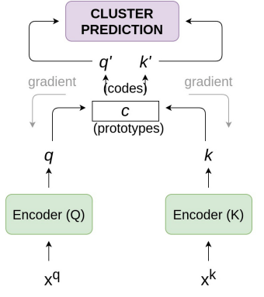
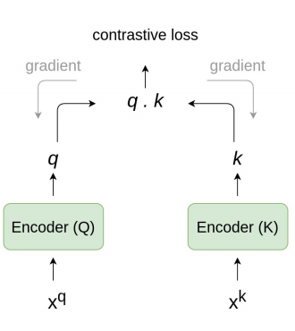
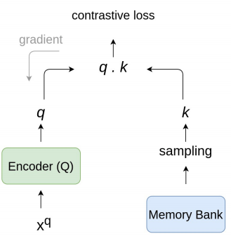
Brief summary
Memory bank
End-to-end
Clustering
Needs to store all features
Needs a large batch size
Needs a large batch size or memory bank
High GPU memory
Jaiswal, Ashish, et al. "A survey on contrastive self-supervised learning." Technologies 9.1 (2021): 2.

Slide 13
Thank you

